Slide 1
Unit 4
MSMEs – Small Scale Industries(SSI)

Slide 2
Are SSI and MSME the same?
Yes. Earlier industries that manufactured goods, produced goods and provided services on a small scale or micro-scale were granted Small Scale Industries (SSI) registration.
Subsequently, the government passed the MSME (Micro, Small and Medium Enterprises) Act in 2006. The small and micro industries came under the MSME Act.
Thus, both SSI and MSME are the same. The government broadened the scope of the SSI and termed it as MSME.

Slide 3
Classification of MSMEs
The government defined MSME in 2018 based on the industry’s yearly revenue. The government argued that sectors should no longer be classified based on their size but rather on their yearly sales. The following are the definitions based on the 2018 turnover:
Micro Industries: Micro industries, or tiny businesses, have annual revenue of fewer than 5 crores rupees.
Small Scale Industries: Small scale industries have annual revenue of between 5 crores and 75 crores rupees.
Medium Industries: The term “medium industry” refers to businesses with yearly revenues ranging from 75 crores to 250 crores rupees.

Slide 4
Introduction
Today. the small-scale industry (SSI) constitutes a very important segment of the Indian economy. Major credit for the development of this sector goes to former Prime Minister Jawaharlal Nehru.
Accounts for 25% industrial production , 40% of Exports and 60% of Employment opportunities have come up on account of SSI.
The small-scale industry (SSI) sector has, over the past six decades, acquired a prominent place in the socio-economic development in the country.
The sector has exhibited positive growth trends even during the periods when other sectors of the economy experienced either negative or nominal growth.
The sector has faced major challenges in finance, marketing, quality, schedule and subcontracting through reposition itself and meet those expanding demands.

Slide 5
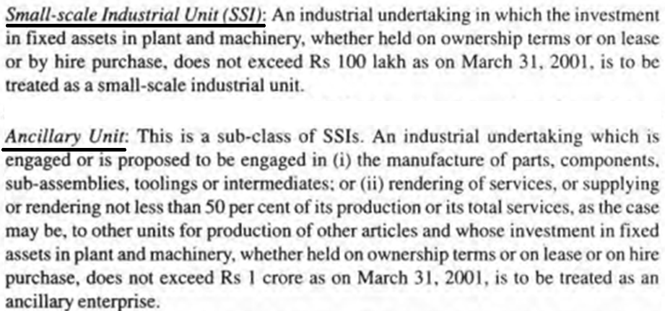

Slide 6
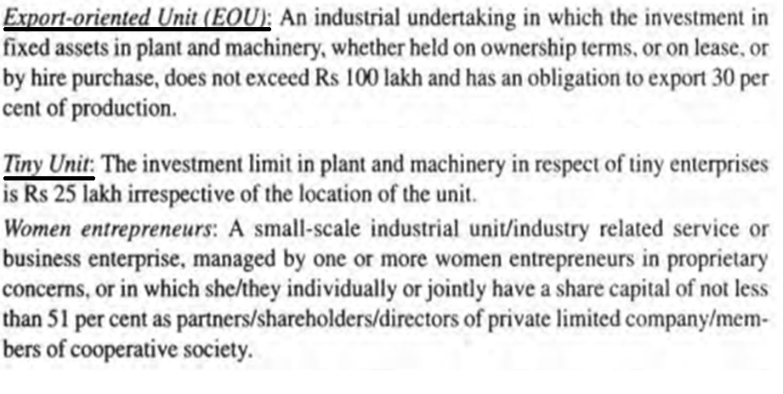
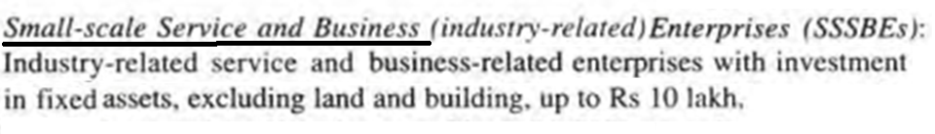

Slide 7
Types of SSSBEs
• Advertising agencies
• Marketing consultancy
• Industrial consultancy
• Equipment rental and leasing
• Typing centers
• Photocopying centers
• Industrial photography
• Industrial R&D laboratories
• Industrial testing laboratories
• Desktop publishing
• Internet browsing/selling up of
cyber cafes
• Auto repair. services and garages
• Documentary films on themes like
social forestry, commercial
advertising and energy saving
• Laboratories engaged in testing of
raw materials. finished products
• Laundry and dry cleaning
• X-ray clinic
• Tailoring

Slide 8
Types of SSSBEs
• "Servicing industry" undertakings engaged in maintenance. repair, testing or
electronic /electrical equipment/instruments. that is. measuring/control
instruments. servicing of all types of vehicles and machinery of any description
including televisions. tape recorders, VCRs. radios. transformers, motors. watches.
and so on.
• Servicing of agriculture farm equipment. for example. tractors, pumps. rigs. boring
machines. and so on
• Weigh bridge
• Photographic laboratory
• Blue printing and enlargement of drawing/design facilities
• ISD/STD booths
• Tele printer /fax services
• Subcontracting exchanges (SCXs) established by industry associations
• EDP institutes established by voluntary associations/non-governmental
organizations
• Colored or black and white studios equipped wi th processing laboratory
• Installation and operation of cable TV network
• Operating EPABX under franchise
• Beauty parlors and crèches

Slide 9
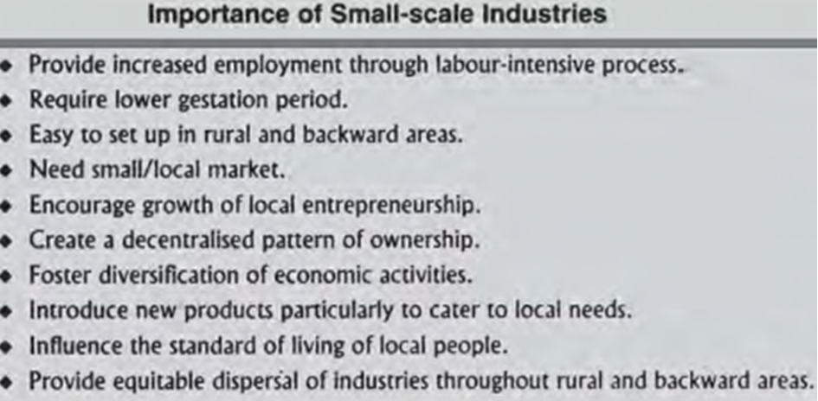

Slide 10
Role of MSMEs:
MSMEs are important to the economy’s growth. MSMEs are consistently a good solution to significant economic difficulties such as poverty, unemployment, income inequality, regional imbalances, and so forth. This ensures that local growth is balanced and that income inequality is preserved. This industry is responsible for reawakening millions of individuals in our nation and utilizing local talent, both of which contribute considerably to the country’s GDP.
Currently, the MSME sector in India is responsible for the development of around 11.10 crore employment. As a result, this industry is often regarded as India’s development engine.
MSMEs contribute significantly to the country’s GDP, accounting for 6-7 percent of the manufacturing sector’s GDP and around 25% of the service sector’s GDP.
MSMEs account for around 40% of overall exports and 45 percent of the country’s industrial output.
In India, there are around 40 million Micro, Small, and Medium Enterprises (MSMEs), both registered and unregistered. Compared to few thousands only in3-4 decades back.
Both organized and unorganized sectors have MSMEs. An MSME firm, like other start-up businesses, confronts several problems in obtaining the necessary financial assistance for various sorts of operations, including establishing the necessary infrastructure to sustain continuous corporate operations. Performing or extending a business, or starting a new one.

Slide 11
Government policies towards MSMEs
The Government of India started the MSME plan, which is a ministry that seeks to offer financial help to small and medium-sized businesses.
This plan also provides financial support as well as the essential marketing and branding for the firm.
The Micro, Small, and Medium Enterprises Development (MSMED) Act established the Ministry of MSME in 2006, with the primary goal of the government developing small and medium companies and providing help as needed.
The MSME industry is divided into two types: 1) Manufacturing Enterprise 2) Service Enterprise

Slide 12
Benefits to MSME:
Bond-free loan facility from the bank: The government has established the Credit Guarantee Fund Scheme (CGS) for small businesses. Only new and old industries are eligible for fast MSME business financing under this program.
Relief in the interest rate on overdraft: The bank ensures that MSME-registered businesses receive a minimum of 1% interest rate reduction in OD (Overdraft).
Payment protection: It has not been stated that if a business loan for MSME registered firms is approved, and the bank fails to pay, the industries would be charged compound interest.
Technology and quality enhancement: MSME-registered enterprises, the Indian government are introducing clean energy. The product’s quality is being improved.
Getting government facility in the marketing of the product: The central government is working to get Indian products acknowledged on a global scale. The government provides financial and medium-term aid to industries to help them sell and brand their products.

Slide 13
Schemes by Government for MSME:
A. Pradhan Mantri Mudra Yojana:
This scheme was started in 2015, and over the course of two years, it created more than 1.8 crore employment through MUDRA loans and businesses. The Pradhan Mantri Mudra Yojana, or PMMY, is the government of India’s main initiative for providing inexpensive finance to micro and small businesses.
Mudra programs aim to “finance the unfunded” by bringing businesses into the official financial system. Non-farm micro and small businesses that generate income through manufacturing, selling, or services are eligible for loans under the PM mudra loan scheme.
This Yojana is one of its kind, created and implemented to encourage Indian businesses. The MUDRA plan allows you to get a loan of up to Rs 10 lakh.
The following are the three types of firms that can apply for a MUDRA loan for their company startup:
Shishu: New businesses – loans up to Rs 50,000/-
Kishor: A mid-aged business – loans between Rs 50,000 and Rs 5 lakh
Tarun: an existing and experienced business- loans between Rs 5 lakh and Rs 10 lakh

Slide 14
B. Prime Minister’s Employment Generation Program (PMEGP):
The scheme’s goal is to enable traditional craftspeople and jobless youngsters in rural and urban regions to generate self-employment prospects by establishing micro-firms in the non-farm sector. The national nodal agency is the Khadi and Village Industries Commission (KVIC). The State Offices of KVIC, Coir Board, KVIB, and District Industries Center (DIC) are the implementing entities at the State/District level.
PMEGP was first launched in 2008-09. Since the program’s launch till September 30, 2020, a total of 6.25 lakh micro-companies have received a margin money subsidy of Rs 14,500 crore, resulting in the employment of 53 lakh persons. 80 percent of the supported units are in rural regions, with Scheduled Castes, Scheduled Tribes, and women owning 50 percent of the units.
From January 2020 to November 30, 2020, 60,211 micro-companies received Rs 1743.84 crore in margin money support, resulting in the creation of 4.81 lakh jobs.

Slide 15
C. Udyog Aadhaar Memorandum:
It is the Indian government’s cost-free, paperless online registration that is easily attainable and applied from any place by using an Aadhaar card.
The advantage of enrolling under these programs is that one can get government credit, loans, and subsidies. You have the option of registering both online and offline. India is home to the world’s highest number of micro, small, and medium-sized businesses (MSMEs).
Furthermore, it is estimated that MSMEs account for about 95% of all industrial units. As a result, almost 42.5 million industries are represented. Only 36 million of these units, however, have been registered.

Slide 16
D. Zero Defect Zero Effect:
Commodities created for export must meet the standard. In addition, some rebates and concessions are available for items exported under this program. The model’s scope includes all industrial and service industries, with a particular emphasis on micro, small, and medium businesses (MSME).
The ZED model aims to improve the quality of the MSME sector, which is currently uncontrolled. The micro, small, and medium-sized enterprise (MSME) sector is the lifeblood of India’s economy. The MSME sector employs over 110 million Indians and provides 38 percent of the country’s GDP.
E. Credit Linked Capital Subsidy Scheme:
This is one of the government’s MSME programs, under which micro, small, and medium businesses can go straight to the bank for subsidies if they wish to update their firm with new technology. The program gives you cash upfront to help you upgrade your manufacturing equipment and procedures.

Slide 17
F. Udyogini Yojana:
It is a government credit program aimed at assisting women in starting businesses and promoting female entrepreneurship in India.
The government’s Women’s Development Corporation provides money for beginning a company under the Udyogini Yojana. Under this plan, the highest loan amount that may be issued is Rs.15 lakh.
There is no requirement for collateral security to get a loan under this arrangement (Security Free Loan). Furthermore, there is no charge for processing.

Slide 18
Impact of LPG on MSMEs
(Liberalization, Privatization and Globalization)
Go through this document for Impact of L P G on SSIs

Slide 19
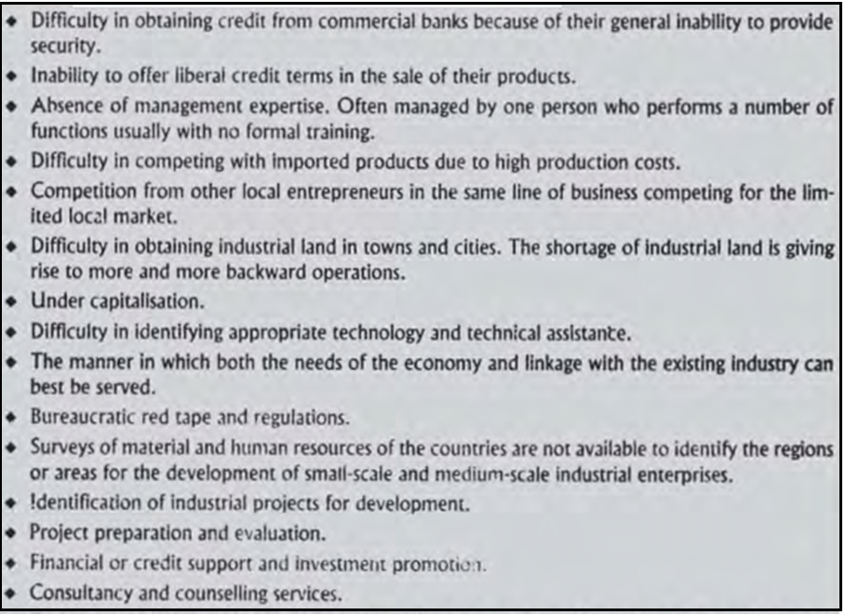
Problems Faced by Small Scale Industries

